Slide 1


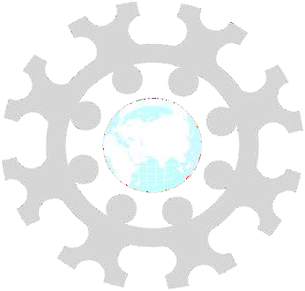
INSTITUTE: UIE (AIT-CSE)
CSS21: B.E. CSE (H) with specialization in Artificial Intelligence & Machine Learning
Advanced Machine Learning (20CSF-349)
Chapter 2.2.5: Support Vector Machine (SVM)
Lecture 23:SVM Kernels
By: Mr. Siddharth Kumar
DISCOVER . LEARN . EMPOWER

Slide 2
Advanced Machine Learning
Course Outcome
CO | Title
1 | Have a good understanding of the fundamental issues and challenges of machine learning: data, model selection, model complexity, etc.
2 | Appreciate the underlying mathematical relationships within and across Machine Learning algorithms and the paradigms of supervised and un-supervised learning
3 | Design and implement various machine learning algorithms in a range of real-world applications.
4 | Design and evaluate intelligent expert models for perception and prediction using machine learning algorithms
5 | Analyze and make use of machine learning algorithms-based applications using performance

Slide 3
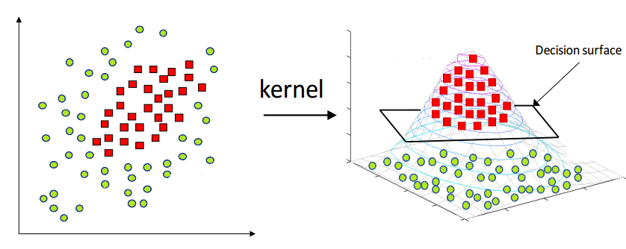
SVM Kernels
It is a simple method where a Non Linear data is projected onto a higher dimension space so as to make it easier to classify the data where it could be linearly divided by a plane.
In SVM, Kernel function is used to map a lower dimensional data into a higher dimensional data. Suppose you have trained an SVM with linear decision boundary after training SVM, you correctly infer that your SVM model is under fitting.
SVM algorithms use different types of kernel functions. These functions can be different types. For example linear, nonlinear, polynomial, radial basis function (RBF), and sigmoid.
Always try the linear kernel first, simply because it's so much faster and can yield great results in many cases (specifically high dimensional problems).

Slide 4
Linear Kernel SVM
The dot-product is called the kernel and can be re-written as:
K(x, xi) = sum(x * xi)
The kernel defines the similarity or a distance measure between new data and the support vectors. The dot product is the similarity measure used for linear SVM or a linear kernel because the distance is a linear combination of the inputs.
Other kernels can be used that transform the input space into higher dimensions such as a Polynomial Kernel and a Radial Kernel. This is called the Kernel Trick.
It is desirable to use more complex kernels as it allows lines to separate the classes that are curved or even more complex. This in turn can lead to more accurate classifiers.

Slide 5
Polynomial Kernel SVM
Instead of the dot-product, we can use a polynomial kernel, for example:
K(x,xi) = 1 + sum(x * xi)^d
Where the degree of the polynomial must be specified by hand to the learning algorithm. When d=1 this is the same as the linear kernel. The polynomial kernel allows for curved lines in the input space.
Radial Kernel SVM
Finally, we can also have a more complex radial kernel. For example:
K(x,xi) = exp(-gamma * sum((x – xi^2))
Where gamma is a parameter that must be specified to the learning algorithm. A good default value for gamma is 0.1, where gamma is often 0 < gamma < 1. The radial kernel is very local and can create complex regions within the feature space, like closed polygons in two-dimensional space.

Slide 6
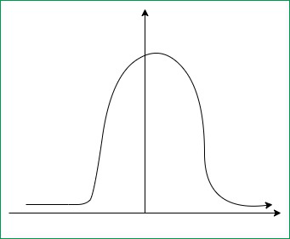
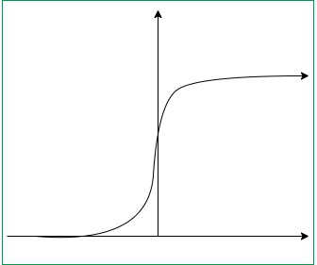
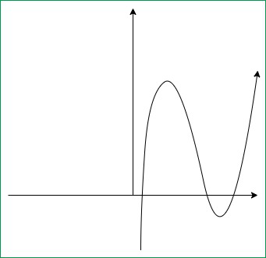
Kernel Tricks
Gaussian Kernel Radial Basis Function (RBF): Basically kernel function is used to perform transformation, when there is no prior knowledge about data. In order to solve this particular problem radial basis method is used to improve the transformation.
Sigmoid Kernel: this function is equivalent to a two-layer, perceptron model of neural network, which is used as activation function for artificial neurons.
Polynomial Kernel: It represents the similarity of vectors in training set of data in a feature space over polynomials of the original variables used in kernel.

Slide 7
References
T1: Mitchell T.M., Machine Learning, McGraw Hill (1997).
T2: Andreas C. Miller, Sarah Guido, Introduction to Machine Learning with Python, O’REILLY (2001).
Notes:
Introduction to Cyber Security (simplilearn.com)

Slide 8

THANK YOU

